Slide 1
DIGITAL SIGNAL PROCESSING PROJECT
VEHICLE NUMBER PLATE DETECTION

Slide 2
INTRODUCTION
Number plates are used for identification of vehicles all over the nations. Vehicles are identified either manually or automatically.
Automatic vehicle identification is an image processing technique of identify vehicles by their number plates.

Slide 3
IMPORTANCE OF NPR
Automatic vehicle identification systems are used for the purpose of effective traffic control and security applications such as access control to restricted areas and tracking of wanted vehicles.
NPR system for Indian license plate is difficult compared to the foreign license plate.

Slide 4
TECHNIQUES USED
Template Creation
Letter Detection
Plate Detection

Slide 5
TEMPLATE CREATION
Here, in the code we are saving the images into a variables by using command ‘imread()’. This function is used to call the images from the folder or from any location of the PC into the MATLAB.
Where A is the variable, and in ‘alpha/A.bmp’, ‘alpha’ is the folder name and ‘A.bmp’ is the file name.
Then create a matrix of ‘letter’ and ‘number’ and save it in variable ‘NewTemplates’ by using command ‘save(filename,variables)’.

Slide 6
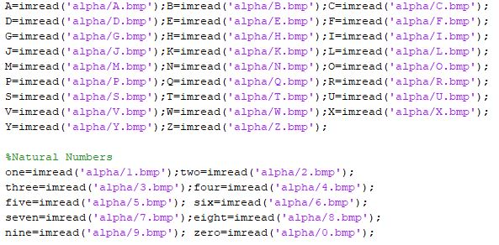
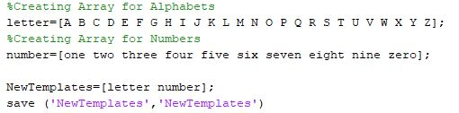

Slide 7
LETTER DETECTION
Here, in the code we have created a function named letter which gives us the alphanumeric output of the input image from class ‘alpha’ by using command ‘readLetter()’. And then load the saved templates by using command load NewTemplates.
After that, we have resized the input image so it can be compared with the template’s images by using the command ‘imresize(filename,size)’. Then for loop is used to correlates the input image with every image in the template to get the best match.

Slide 8
A matrix ‘rec’ is created to record the value of correlation for each alphanumeric template with the characters template from the input image.
Then ‘find()’ command is used to find the index which corresponds to the highest matched character. Then according to that index, corresponding character is printed using‘if-else’ statement.

Slide 9
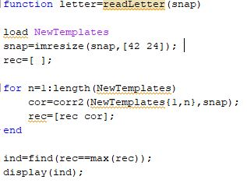


Slide 10
PLATE DETECTION
we are calling the input image and converting it into the grayscale. Then the grayscale is converted into the binary image, and the edge of the binary images is detected by the Prewitt method.
Then the below code is used to detect the location of the number plate in the entire input image

Slide 11
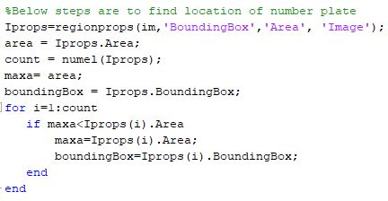

Slide 12
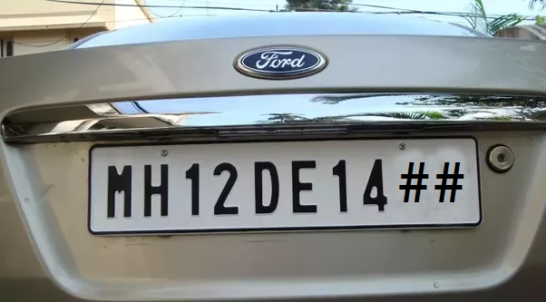
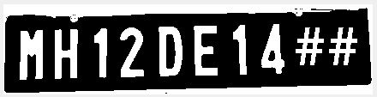
RESULTS

Slide 13
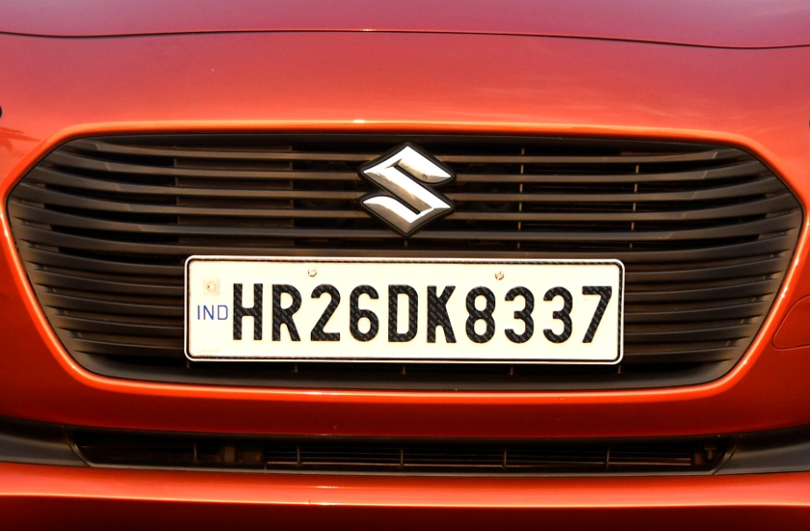
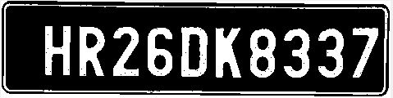

Slide 14
APPLICATIONS
Parking :- The NPR is used to automatically enter prepaid members and calculate parking fee for nonmembers.
Access control :- A gate automatically opens for authorized members in a secured area, thus replacing or assisting the security guard.
Tolling :- The car number is used to calculate the travel fee in a toll-road or used to double check the ticket.
Border Security :- The car number is registered in the entry or exits to the country and used to monitor the border crossings

Slide 15
CONCLUSION
In this system , an application software is designed for the detection of number plate of vehicles using their number plate.
Some of possible difficulties:
1. Broken number plate.
2. Blurry images.
3. Number plate not within the legal specification.
4. Low resolution of the characters.
5. Poor maintenance of the vehicle plate.
Similarity between certain characters, namely, O and D; 5 and S; 8 and B, E; O and 0, etc.

Slide 16
REFERNCES
INTERNATIONAL JOURNAL OF INNOVATIVE RESEARCH IN ELECTRICAL, ELECTRONICS, INSTRUMENTATION AND CONTROL ENGINEERING Vol. 2, Issue 8, August 2014 Copyright to IJIREEICE www.ijireeice.com •
Circuit Digest

Slide 17
PREPARED BY:
ABHISHEK JENA
B216002
ETC
UNDER THE GUIDANCE OF:
Dr. BIJAYANANDA PATNAIK
ETC DEPARTMENT

Slide 18
THANK
YOU

